Slide 1
POWER PLANT ELECTRICAL OUTPUT PREDICTION

Slide 2
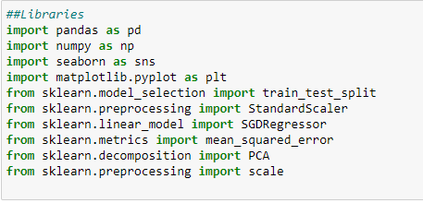
IMPORTING REQUIRED LIBRARIES

Slide 3
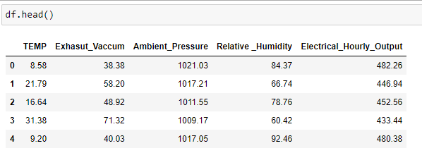
READING THE DATA

Slide 4
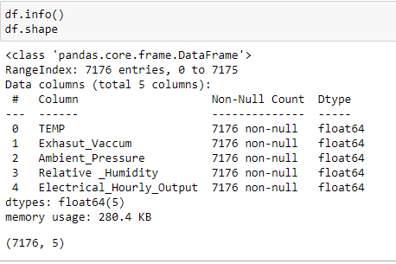
DIMENSIONS OF THE DATA
There are 7176 rows and 5 columns.
Data set consists of all numerical variables.

Slide 5
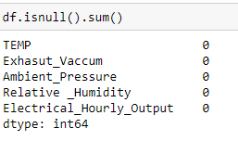
Missing values
No missing values

Slide 6
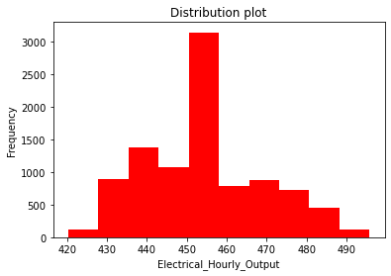
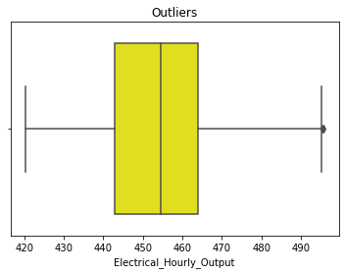
EDA
1.Analyzing Target Variable
We can clearly observe that Electrical output is ranging from 420 to more than 490 KW.
The distribution mostly normal.Let us check for outliers.
Very few outliers near to threshold limit.

Slide 7
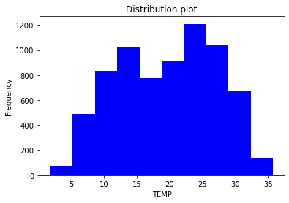
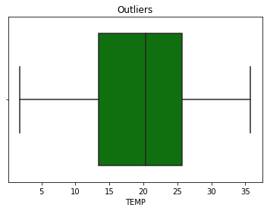
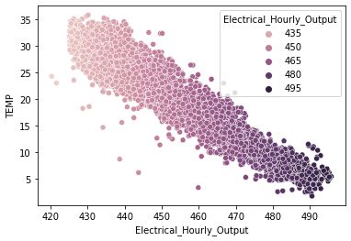
EDA
2. Temperature
We can clearly observe that temperature is ranging from less than 5 degrees to 35 degrees..
The distribution mostly normal. Let us check for outliers.
No outliers
Scatter plot between Electrical output and temperature
There is more output when temperature is less and the density of data near to high output is less.

Slide 8
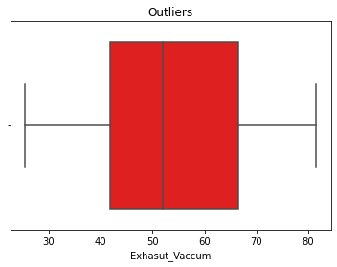
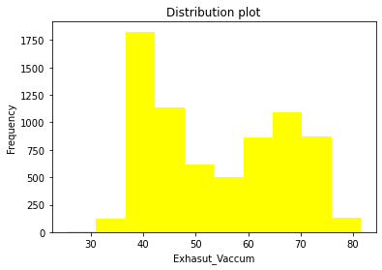
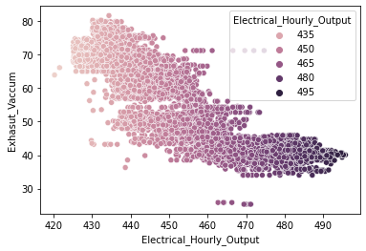
EDA
3.Exhaust vacuum
We can clearly observe that exhaust vacuum is ranging from less than 30 to more than 80 degrees..
The distribution mostly normal. Let us check for outliers.
No outliers
Scatter plot between Electrical output and exhaust vacuum
There is equal output through out all vacuum values. The density of data is almost equal.

Slide 9
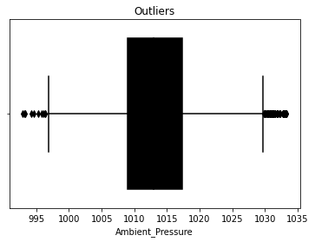
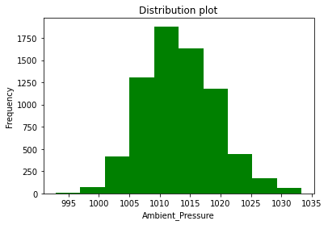
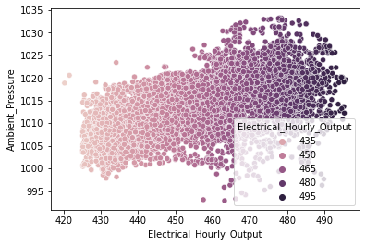
EDA
4.Ambient Pressure
We can clearly observe that pressure is ranging from 1000 to more than 1035 ..
The distribution is normal. Let us check for outliers.
Very less percentage of outliers(less than 1%n are present at both the limits.
Scatter plot between Electrical output and Ambient Pressure

Slide 10
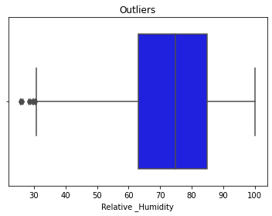
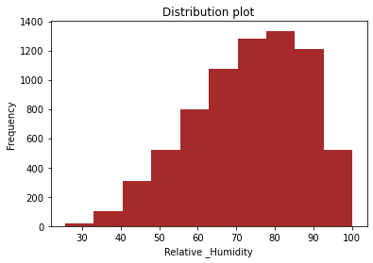
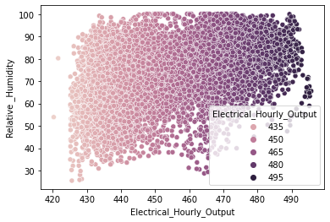
EDA
5.Relative Humidity
We can clearly observe that Humidity is ranging from 30 to more than 100 ..
The distribution is negatively skewed. Let us check for outliers.
Scatter plot between Electrical output and Relative Humidity

Slide 11
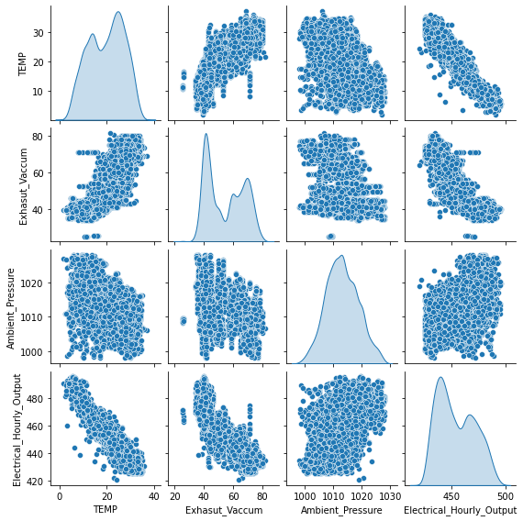
EDA
PAIR PLOT

Slide 12
EDA
HEAT MAP

Slide 13
MODEL BUILDING
We are going to predict and check the different R_Square scores using below Regression.
SGD Regression
PCA and SGD
VIF and SGD

Slide 14
Final Scores Comparisons
MODEL | RMSE | SCORE
1 | PowerPlant SGD model | 4.537990 | 0.928525
2 | PowerPlant SGD PCA model | 7.030544 | 0.833522
3 | PowerPlant SGD3 model | 4.667414 | 0.928525
RMSE

Slide 15
THANK YOU

